Slide 1



B5G/6G Cyber Security Testbed
Prof. Alessandro Carrega
alessandro.carrega@unige.it
TNT (Telecomm. Networks and Telematics) Lab
Unige - University of Genoa
CNIT- National Inter-University Consortium for Telecommunications

Slide 2
INTRODUCTION
Mobile communication has evolved from 1G to the anticipated 6G, improving speed, capacity, and connectivity.
5G & 6G enable:
Ultra-Reliable Low-Latency Communications (URLLC).
Massive Machine-Type Communications (mMTC).
Enhanced Mobile Broadband (eMBB).
Driven by:
High-speed data demand.
Proliferation of IoT devices.
Need for seamless connectivity.
Notes:
Highlight the major milestones from 1G to 6G, emphasizing the shift in performance and capabilities.
Explain how 5G and 6G are not just incremental upgrades but transformative technologies enabling new applications.
Mention the role of IoT and cross-platform connectivity in driving these advancements.

Slide 3
INTRODUCTION
B5G & 6G characteristics
Higher frequency bands: millimeter waves & terahertz.
Integration of AI/ML for efficient network management.
Cybersecurity concerns
Vulnerabilities due to complex, interconnected networks.
Threats: DoS attacks, data breaches, APTs.
Critical to ensure integrity, confidentiality, availability.
CNIT-S2N Testbed
State-of-the-art environment for 5G/6G research.
Supports testing of protocols, applications, and security measures.
Emulates complex topologies & integrates cybersecurity frameworks.
Notes:
Emphasize the increasing complexity of 5G/6G networks and why cybersecurity is critical.
Discuss the types of cyber threats and potential consequences.
Introduce the CNIT-S2N testbed as a controlled platform enabling safe experimentation and evaluation of security strategies.

Slide 4
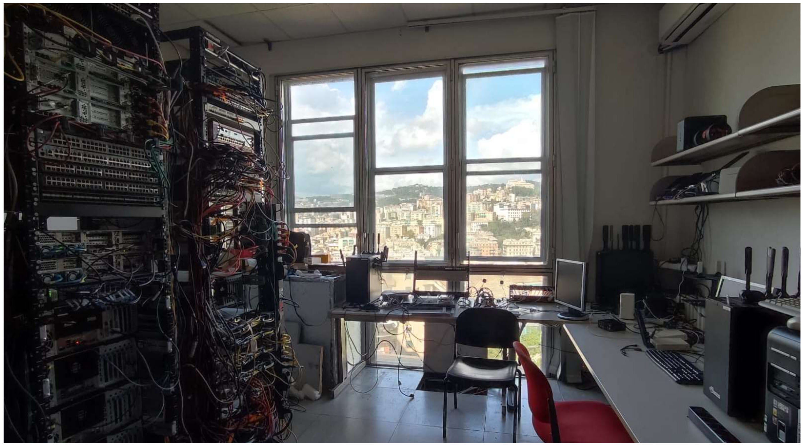
CNIT-S2N Testbed Overview
Location: Genoa, Italy.
Supports research on B5G/6G, Edge, and Cloud Computing.
Multi-layered HW/SW platform with isolated environments (islands).
Part of European H2020 projects: HORSE, Nephele, MARE, SLICES, etc.
Notes:
Explain that the testbed allows multiple researchers to run experiments in parallel without interference.
Highlight participation in European projects for standardization.

Slide 5
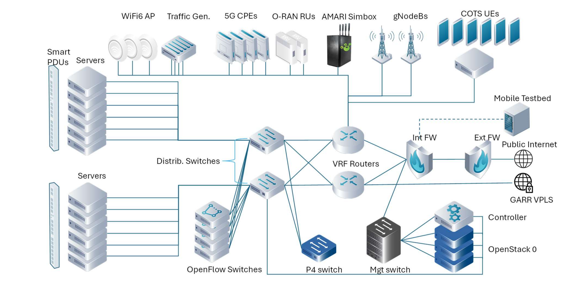
Testbed Architecture & Core Components
Network Infrastructure: High-speed backbone, fiber optics, mmWave, wireless.
Computational Resources: High-performance servers and GPUs for AI/ML workloads.
Security Frameworks: IDS, firewalls, encryption protocols.
Supports isolated islands for full B5G/6G network emulation.
Notes:
Emphasize modularity and scalability.
Explain how the testbed supports realistic cybersecurity experiments.

Slide 6
Hardware & Software Components
Hardware
35 servers
8 switches
Amarisoft 5G base stations
NVIDIA A100 GPUs
P4-enabled switch
traffic generators
12 UE devices
Software
OpenStack
OSM
Kubernetes
VNFs
DPDK emulation
ONOS SDN controller
Prometheus & ELK monitoring
Notes:
Highlight ability to emulate complex network topologies.
Mention software stack for orchestration, monitoring, and network testing.

Slide 7
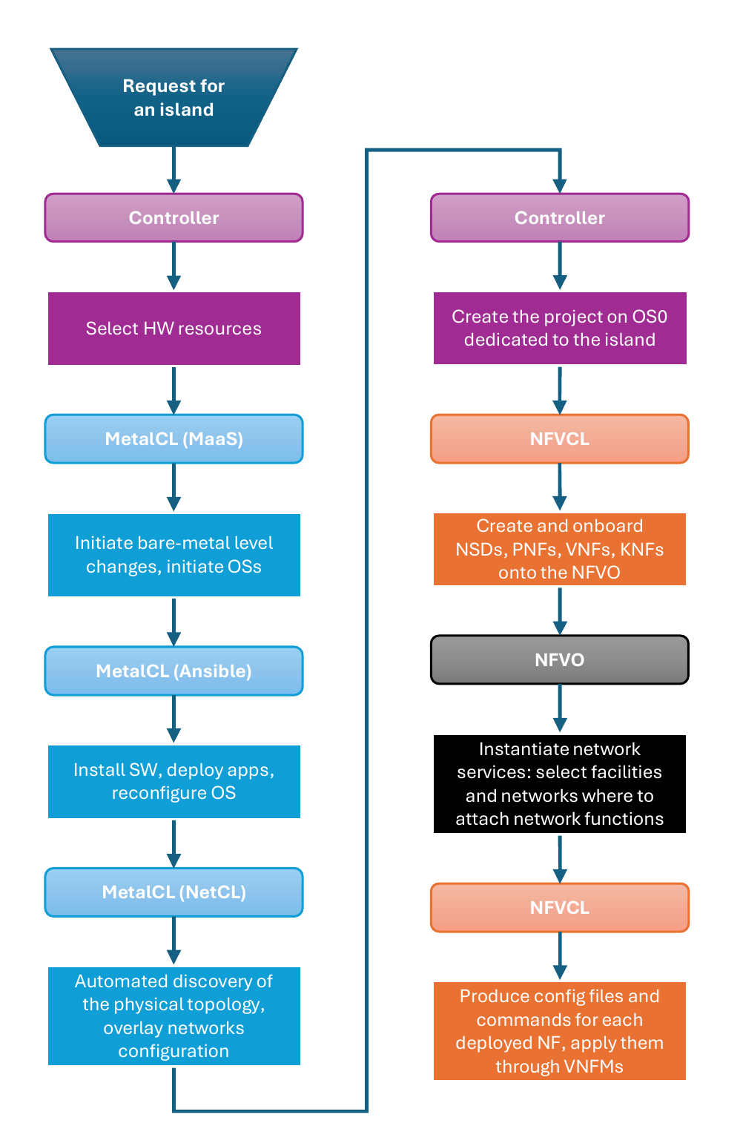
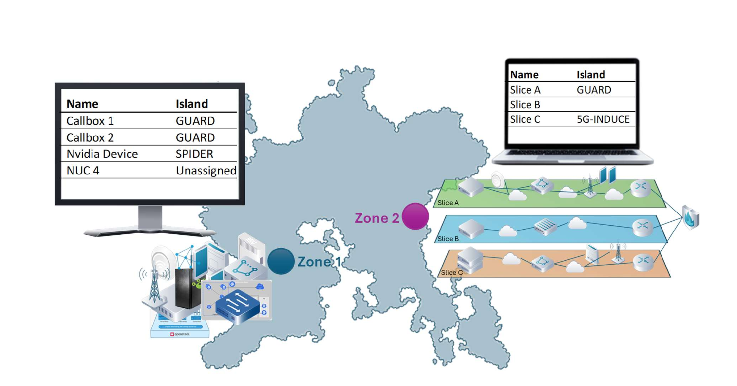
Flexible Management & Orchestration
Metal-CL: Bare-metal provisioning with MAAS + Ansible.
Net-CL: Automates topology discovery, VLAN overlay configuration.
NFV-CL: Orchestrates VNFs/PNFs using blueprints.
Supports federated zones with different programmability levels.
Notes:
Explain orchestration of both physical and virtual network components.
Emphasize isolated islands and flexible programmability.

Slide 8
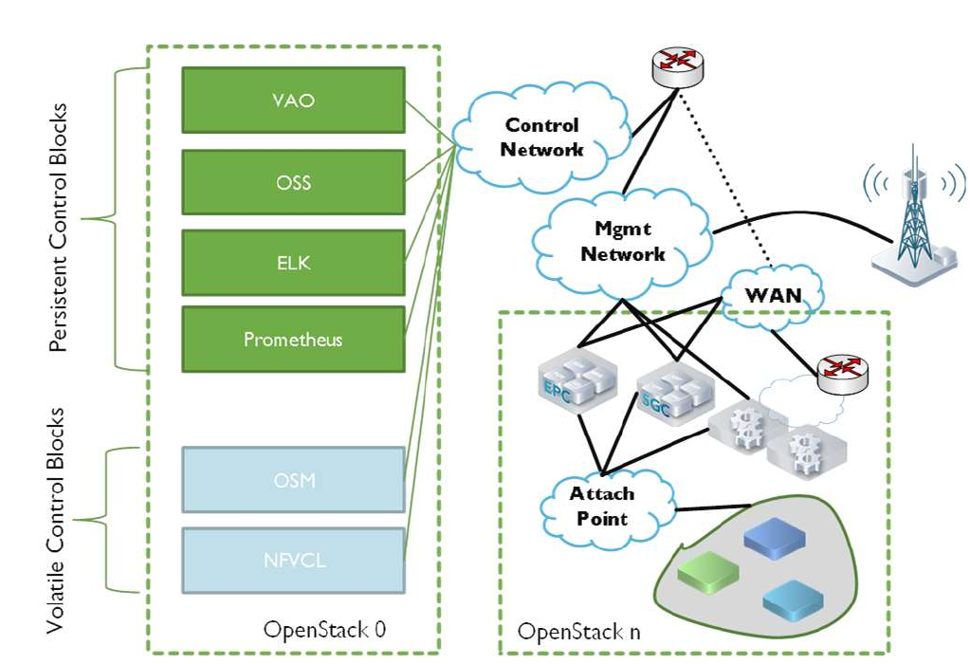
Cybersecurity Focus
Each island fully isolated by internal firewall.
Deploy custom security functions (xNFs).
Test IDS, firewalls, and other security mechanisms.
Observability stack monitors network behavior in real-time.
Notes:
Highlight importance of isolation for cybersecurity research.
Mention P4 switch programmability for real-time threat mitigation.

Slide 9
Security & Performance Use Cases
Vulnerability Assessment: Identify potential weaknesses.
Penetration Testing: Simulate attacks in a controlled environment.
Performance Evaluation: Test network under load and attacks.
Supports AI/ML-based security solutions for adaptive threat detection.
Notes:
Explain how these use cases help optimize network security and performance.

Slide 10
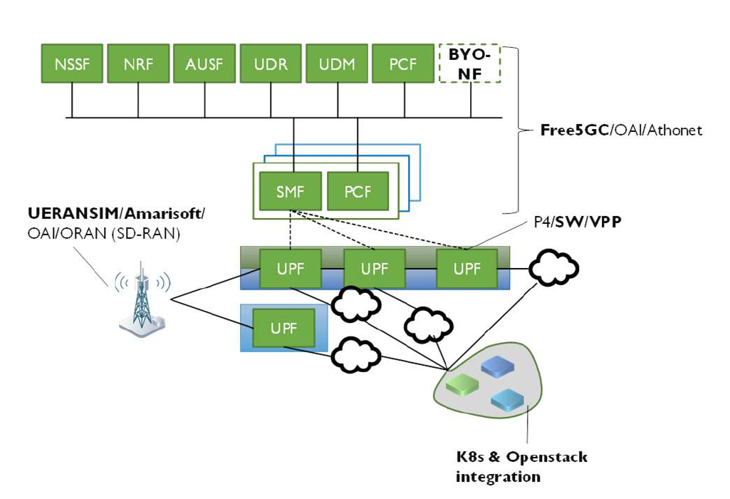
Core Deployment & Security Integration
NFV-CL enables deployment of full 5G/6G core networks.
Supports BYONF for custom security network functions.
P4 switch and traffic generators enable real-time threat testing.
Secure remote access via VPNs
Notes:
Reinforce that the testbed is ideal for cybersecurity research.
Mention real-time observability and threat simulation for experiments.

Slide 11
Cybersecurity Use Cases of CNIT-S2N Testbed
Testbed supports diverse use cases: vulnerability research, network function testing, cyber-attack simulation.
Uses MaaS approach to automate provisioning (HW, SW, OS, configurations).
Rapid, reproducible setup for VNFs, SDN switches, radio devices.
Offers dedicated isolated instances for independent experiments.
Enables assessment of AI-based threat detection and cyber-physical attacks.
Notes:
Highlight the automation advantage (declaration-based resource provisioning).
Mention isolation ensures reproducibility and reliability in security experiments.

Slide 12
Evolving Toward 6G Cybersecurity Research
Focus on bridging cyber and physical domains.
Integration of digital twins for real-time coordination and control.
Improved spectrum aggregation and programmable infrastructure for 6G.
Development of new authentication and cryptography systems.
Focus on AI/ML-based threat detection and vulnerability research.
Notes:
Explain that testbed is evolving for next-gen security challenges (quantum & AI-driven threats).
Stress the modular design for simulating future 6G interfaces and APIs.

Slide 13
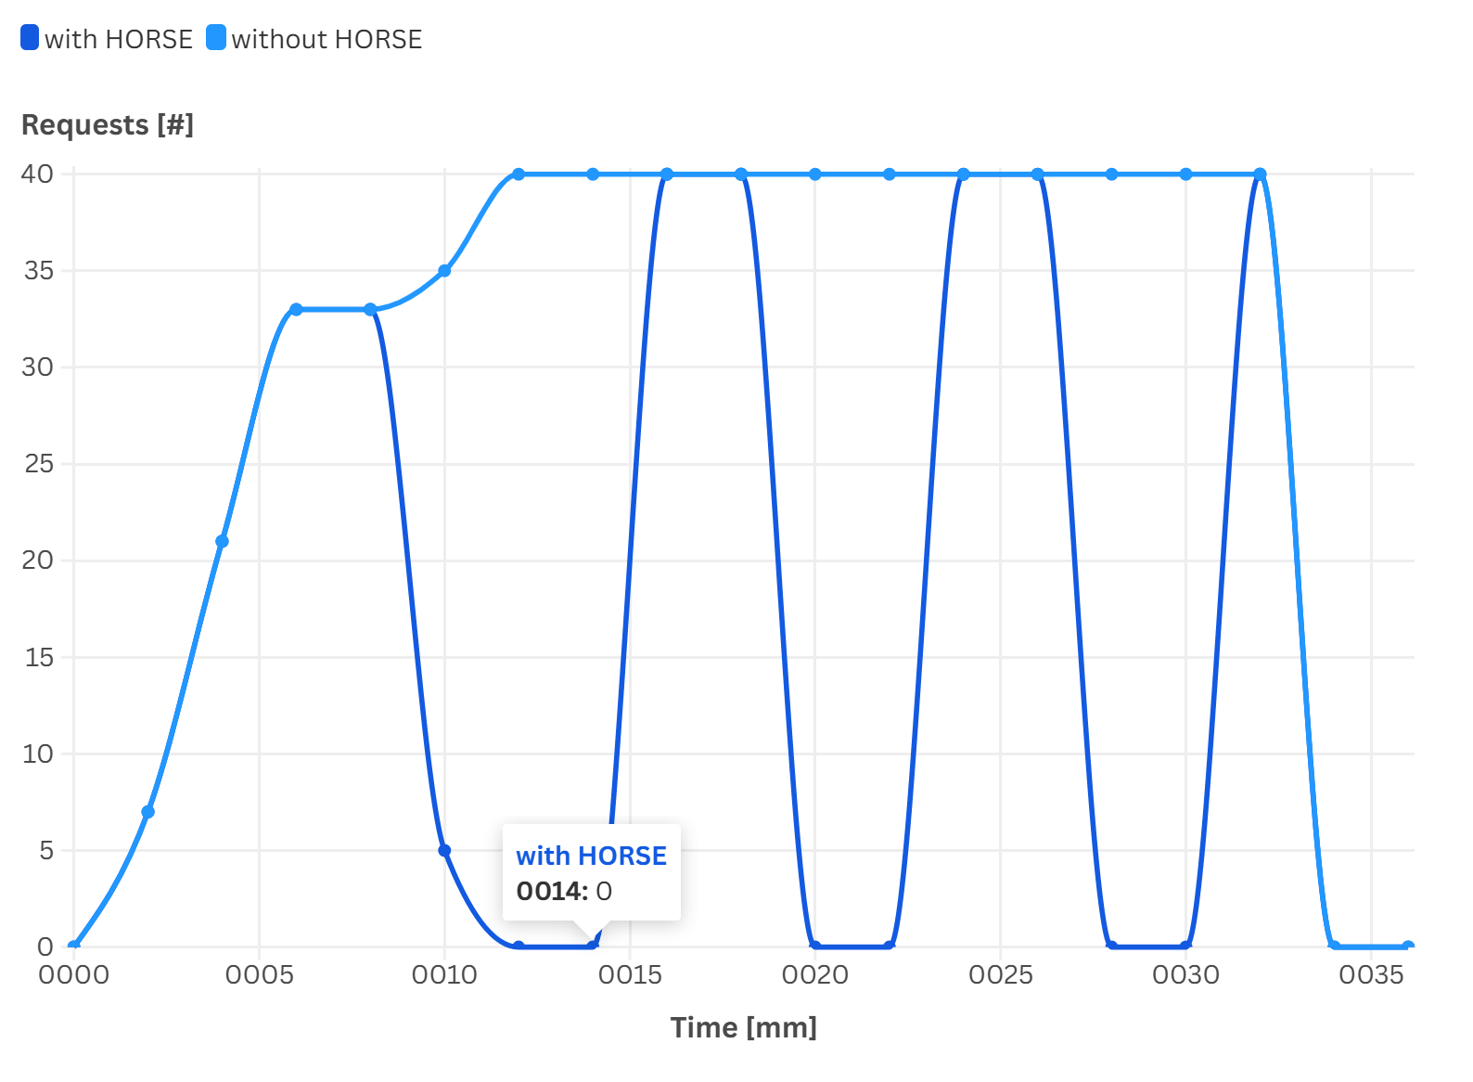
API Exposure Attack Simulation
APIs exposed by NEF can leak sensitive info (routing, location, mobility).
HORSE framework + testbed used for brute-force API attack detection.
SM module collects logs → pre-processed for DEME anomaly detection.
DTE + IBI enforce mitigations (e.g., filter requests, modify policies).
Enables accurate attack replication and response validation.
Notes:
Describe how HORSE detects and mitigates brute-force API exposures.
Mention the workflow: detection → intent generation → enforcement.
Figure: api-exp-results here

Slide 14
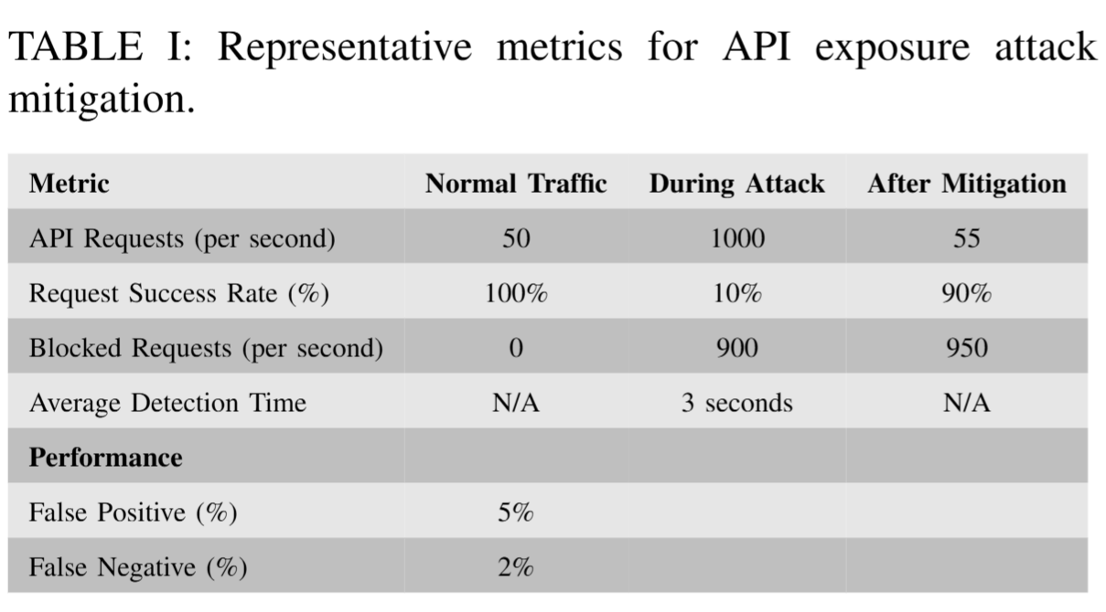

Slide 15
DDoS Attack Emulation and Mitigation
Simulates large-scale DNS/NTP DDoS within isolated islands.
HW traffic generators and VRFs ensure realistic attack traffic.
HORSE + digital twins predict and analyze attack impacts.
DEME/DTE detect and trigger mitigations (rate-limiting, filtering).
Observability stack (Prometheus, ELK) monitors real-time effects.
P4-enabled switch enforces real-time data-plane security policies.
Notes:
Highlight that the testbed allows full-scale DDoS simulation safely.
Stress programmability and AI-assisted mitigation testing.

Slide 16
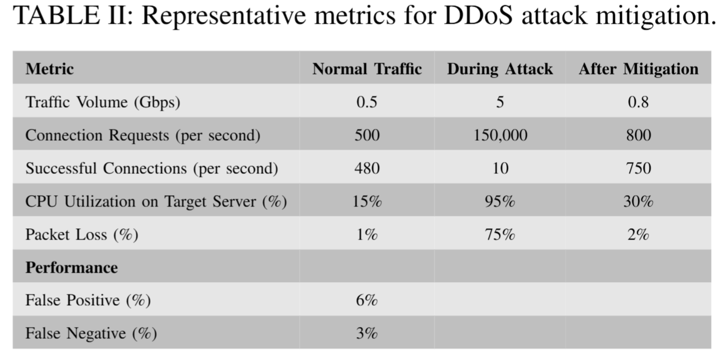

Slide 17
Practical Domains and Real-World Use Cases
Education:
Students deploy isolated 5G/6G networks.
Simulate DDoS attacks and test P4/ML-based countermeasures.
Industry:
Smart factory digital twin for cyber-physical training.
Detect and mitigate API exposure and DoS on AGVs.
Train teams using real ML-based traffic classification tools.
Healthcare:
Secure telemedicine and remote surgery communications.
Simulate MITM attacks and test encryption or routing countermeasures.
Use digital twin for what-if analysis of mitigation strategies.
Notes:
End with how CST bridges education, industry, and healthcare.
Emphasize its versatility and real-world relevance.

Slide 18
Conclusion and Future Outlook
The CNIT testbed is a cornerstone for B5G/6G cybersecurity research.
Demonstrates the need for robust, adaptive security measures in next-generation networks.
Future research will focus on:
AI-driven threat detection
IoT security and data integrity
Cross-sector collaboration with academia and industry.
The testbed will remain at the forefront of innovation, supporting continuous development of resilient and secure 5G/6G infrastructures.
Notes:
Conclude by linking the testbed’s ongoing contributions to the broader evolution of secure 6G ecosystems and its pivotal role in research, validation, and education.

Slide 19

End of Presentation
Thank You for your attention
Questions & Discussion.

